Slide 1

CONTINUOUS INTEGRATION
THE VIRTUOUS CYCLE
Ozan Seymen – Apigee Principal Architect
Diego Zuluaga – Apigee Principal Architect
Notes:
Hi, my name is boo. This is foo. We’re from Apigee prof services. We’ve implemented 100s of projects for various customers. Today we will share our experiences and lessons learned on CI practices. Many customers out there are unable to get their code in production. We want to show you the tools and processes to do that and hopefully you can use these for the benefit of your organisation.
METRICS:
did I execute faster
reduction in problems after launch. P1s
reduction in CS hours
We’ve seen 6 months to 2 weeks.
But also have entire org - in general we reduced blah blah by 20%.

Slide 2
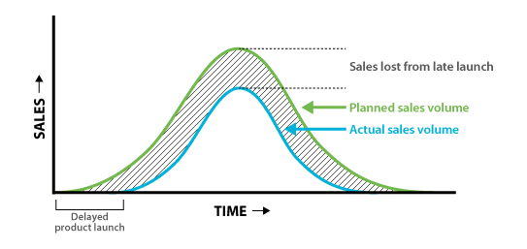
The ultimate goal of CI is Faster Time to Market TTM

Slide 3

Reality Check: code that doesn’t go to production...

Slide 4

Why is it so hard?
Let’s take a look at the tasks required:
Clean API Bundle Files and Folders
Copy Artifacts
Configure DEV, QA, STG, PROD, etc.
Package Artifacts (zip)
Deactivate last revision
Import and deploy API bundle
Execute Unit Tests
Execute Functional Tests
Execute Performance Tests
Deploy and Test Documentation on CMS
Any other manual tasks…
There must be a way to automate all this tedious work!

Slide 5
How do we solve this?

Slide 6
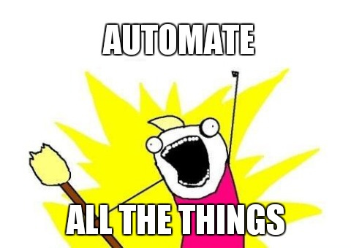
A common reaction is...

Slide 7

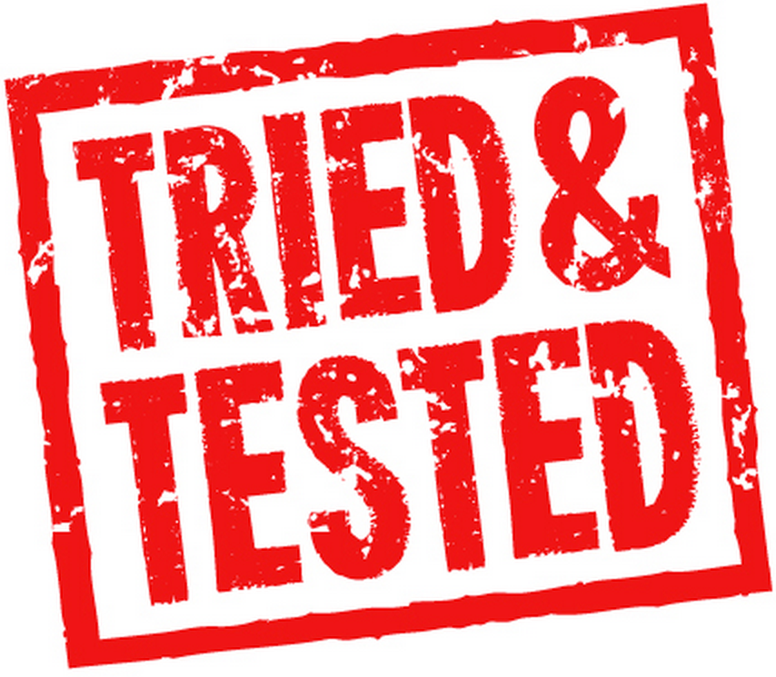
Fortunately, there’s a solution for that
by
Apigee Customer Success

Slide 8
Who’s doing it? and Why?
Experience has taught us that developers and API Teams prefer:
Short development iterations and fast feedback
Battle-tested frameworks embraced by open communities
Developer-friendly scripting languages
Frameworks that easily integrate with CI infrastructure

Slide 9
Who’s doing it? and Why?
Customers: BBC WorldWide, Telefonica Chile, AT&T, T-Mobile, Everything Everywhere, Autodesk, Intralinks, L.L.Bean, FX Networks, Morrisons, Equinix, Cambia, Waitrose, Millicom (Tigo), GLH Hotels, among others.
Trivia…
How many weeks in average would take to pump code to prod? For API Teams under Apigee Blueprint Program
Apigee has enabled companies releasing code to prod on a daily basis instead of every six months without losing any traffic!

Slide 10
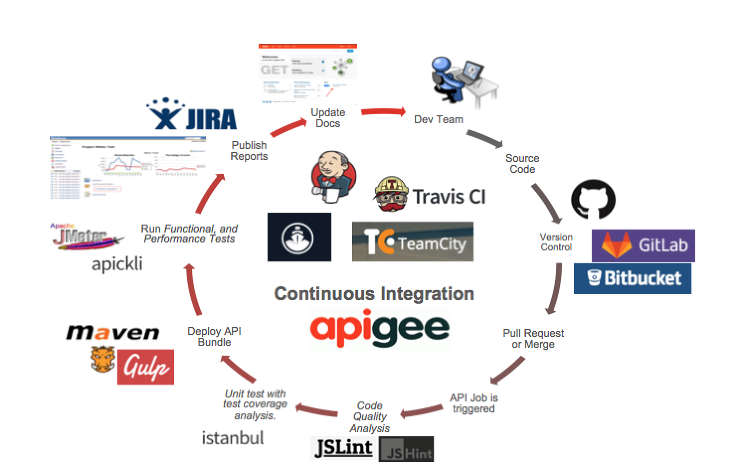
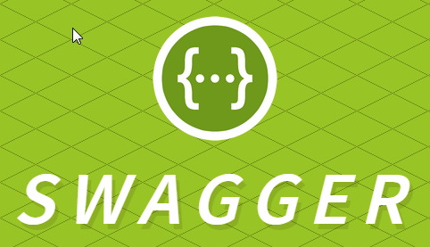




Enter The Virtuous Cycle
Newman
Notes:
swagger-test-templates

Slide 11

Version Control

Slide 12
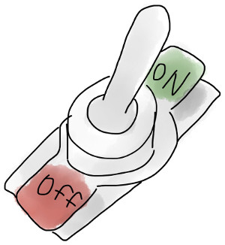


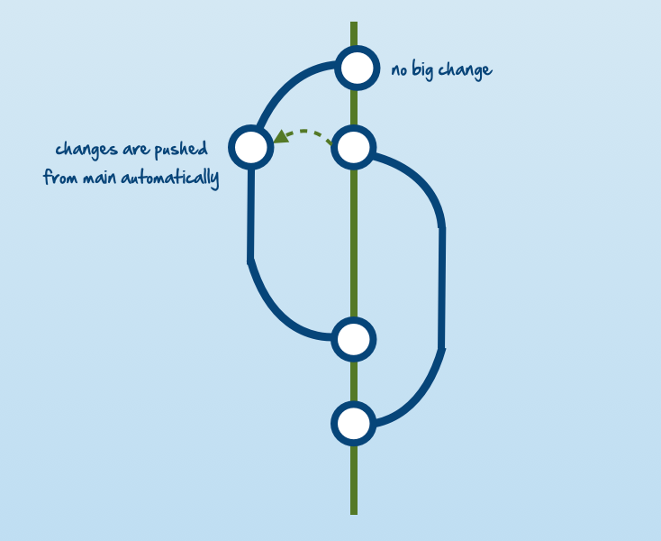

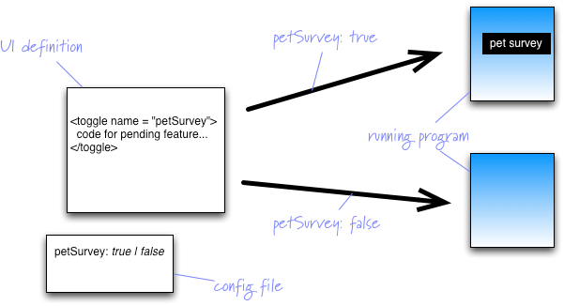
Version Control: You need a winning branching Model!
Gitflow
Notes:
swagger-test-templates

Slide 13
Code Quality Analysis

Slide 14
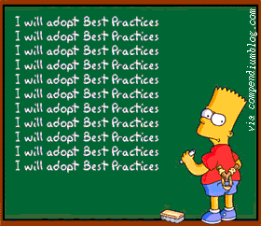
Static Code Quality Analysis
We have the functionality to attach custom code to any flow within Apigee. These can be written in Java, JS, Python and Node.js
Recommendation is to run static code analysis for these custom code in Apigee proxy
Promote consistency and follow best practices for the language you are using
Notes:
As you know we have the option to write custom extension policies in Apigee using Java, Javascript, Python and node.js. One thing we recommend and do consistently within projects we implement as Apigee professional services is to use and integrate static code quality checking
This is to promote consistency in the codebase and let us follow best practices for the language we are using.

Slide 15
Static Code Quality Analysis
AUTOMATE!
Integrate with your editor
Hooks for source control
Grunt/gulp watcher
Continuous integration/build systems
Notes:
At Apigee professional services, we are automating these things and this helps a lot in catching some of the nasty bugs before uploading proxies to cloud.

Slide 16



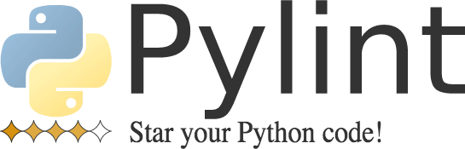

Static Code Quality Analysis
LINT4J

Slide 17
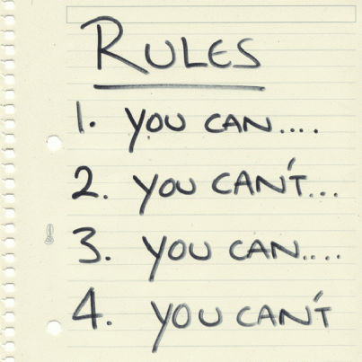


Static Code Quality Analysis
Notes:
Some of the rules are opinionated – if you are a veteran of the language you are using, you may not agree with all the rules. You always have the option of disabling some of the checks but I still believe there is value in applying large percentage of these rules to your codebase especially if you are new to that language.
Let me demonstrate a couple of scenarios that code analysis is quite useful.
In order to show you some code, I needed to choose a language and I will concentrate on JS for this as it is one of the most used languages in Apigee community.
Type cohersion
if (a == false) { alert ('a is false'); }
One line if
Switch fall through
Regular expression ^
Unused variables – useful especially during heavy refactoring
Security stuff… (have non at the moment apart from validation regular expression)

Slide 18
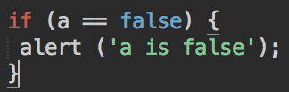
Static Code Quality Analysis
Notes:
This is the famous 2 = 3 = scenario
(W116) Expected '===' and instead saw '==‘
If you are familiar with JS than you know that there is an inherent boolean value for all types. These are referred to as truthy and falsy.
So == does not compare the types of the operands.
In this example, you will get an alert if:
If a is false
If a is 0, then we will get an alert.
If a is “”

Slide 19
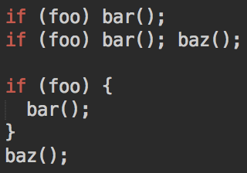
Static Code Quality Analysis
Notes:
Curly braces in block code
JS tools complain if there is an if block without braces even if it has a single line of code in it. It believes it is confusing and will cause hard-to-trace bugs.
My personal feeling is that “there is no good reason not to use braces”. It won’t hurt. But is a personal preference. I think the third block is very clear.
(W116) Expected '{' and instead saw 'bar’

Slide 20
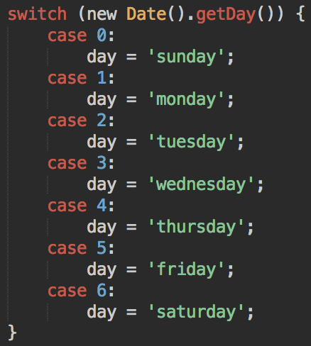
Static Code Quality Analysis
Notes:
(W086) Expected a 'break' statement before 'case’
Best code ever – everyday is Saturday. Because there are no breaks.

Slide 21
Deployment

Slide 22
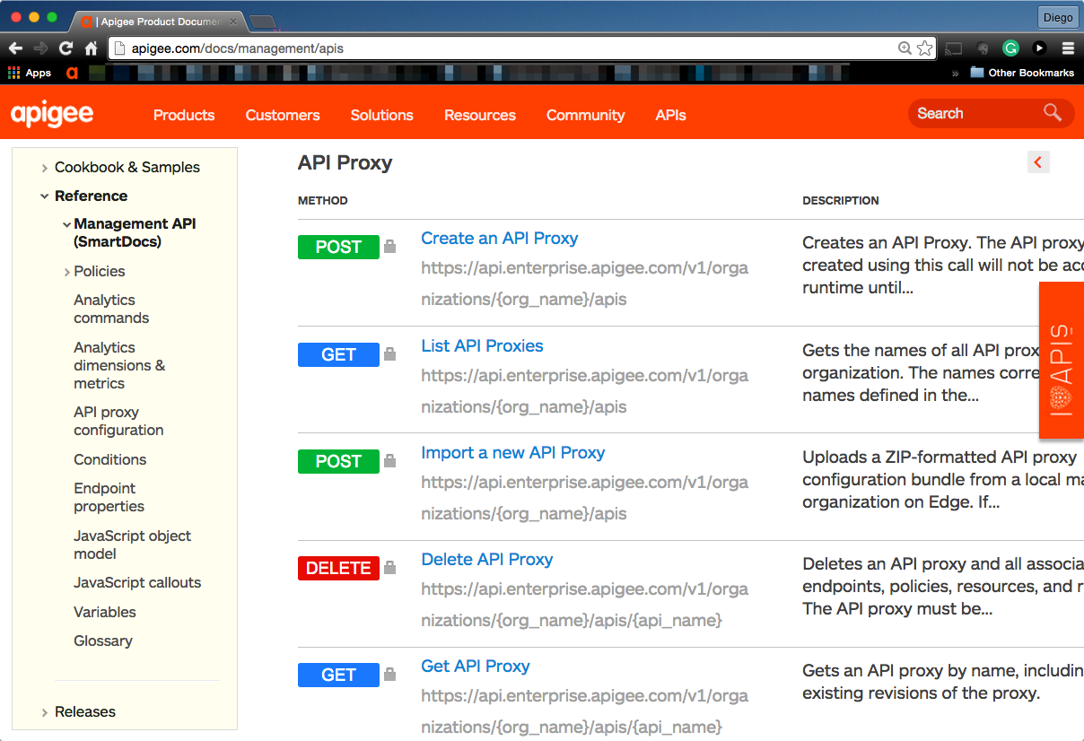
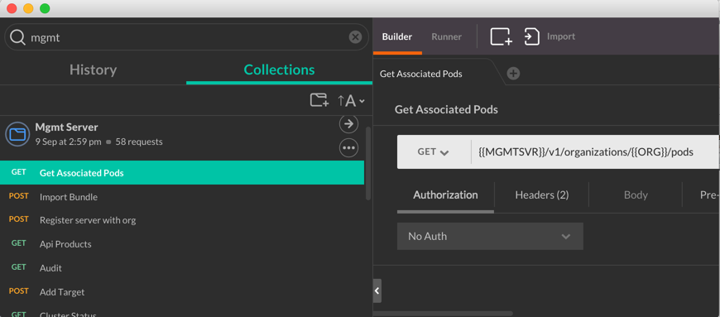

Management API is part the secret sauce
All tools leverage, Apigee Management API
Get it here:
http://apigee.com/docs/management/apis
Get it here:
https://github.com/apigee/apigee-management-api-postman

Slide 23




Deployment through build tools
Apigee Maven Plugin
Apigeetool
Coming soon
Apigee Grunt Generator/Plugin

Slide 24
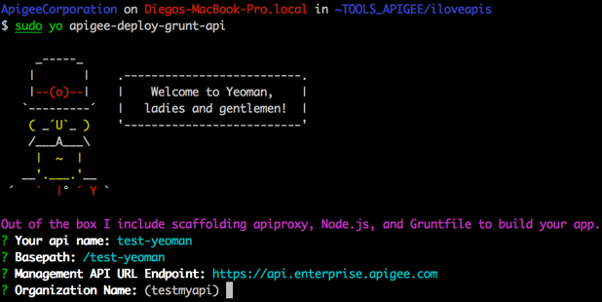
Deployment through build tools
Get Apigee Grunt plugin now! https://github.com/apigeecs/apigee-deploy-grunt-plugin
Yeoman as proxy generator. Fork it and customize it to your needs!

Slide 25
Deployment through build tools - Apigee Grunt
grunt.registerTask('buildApiBundle', 'Build zip without importing to Edge', ['apigeeGruntPluginBanner', 'prompt', 'clean', 'saveGitRevision', 'shell:apigee_npm_node_modules', 'mkdir', 'copy', 'xmlpoke', 'string-replace', 'jshint', 'eslint', 'complexity', 'compressAlias',
'istambul_coverage',]); //3. import revision and run seamless deployment grunt.registerTask('DEPLOY_IMPORT_BUMP_SEAMLESS_REVISION', [ 'buildApiBundle', 'getDeployedApiRevisions', 'apigee_import_api_bundle', 'installNpmRevisionAlias', 'deployApiRevisionAlias', 'executeTests',
'shell:run_mocha_tests',
'shell:run_jmeter_tests', 'notify:ApiDeployed']);
// importKVM at Organization and Environment level. See apigee_kvm task above grunt.registerTask('importKVMs', ['apigee_kvm:' + grunt.config.get("apigee_profiles")[grunt.option('env')].org + '-' + grunt.option("env"), 'apigee_kvm:' + grunt.config.get("apigee_profiles")[grunt.option('env')].org]);

Slide 26
Deployment through build tools
Get it now! https://github.com/apigee/apigee-deploy-maven-plugin
<project xmlns="http://maven.apache.org/POM/4.0.0" xmlns:xsi="http://www.w3.org/2001/XMLSchema-instance" xsi:schemaLocation="http://maven.apache.org/POM/4.0.0 http://maven.apache.org/xsd/maven-4.0.0.xsd"> <modelVersion>4.0.0</modelVersion> <groupId>apigee</groupId> <artifactId>parent-pom</artifactId> <packaging>pom</packaging> <version>1.0</version> <build> <plugins> <plugin> <artifactId>maven-clean-plugin</artifactId> <version>2.5</version> </plugin> <plugin> <groupId>io.apigee.build-tools.enterprise4g</groupId> <artifactId>apigee-edge-maven-plugin</artifactId> <version>1.0.0</version> <executions> <execution> <id>configure-bundle</id> <phase>package</phase> <goals> <goal>configure</goal> </goals> </execution> <execution> <id>deploy-bundle</id> <phase>install</phase> <goals> <goal>deploy</goal> </goals> </execution> </executions> </plugin> </plugins>

Slide 27
Deployment through build tools
Get it now! https://github.com/apigee/apigee-deploy-maven-plugin
<project xmlns="http://maven.apache.org/POM/4.0.0" xmlns:xsi="http://www.w3.org/2001/XMLSchema-instance" xsi:schemaLocation="http://maven.apache.org/POM/4.0.0 http://maven.apache.org/xsd/maven-4.0.0.xsd"> <modelVersion>4.0.0</modelVersion> <groupId>apigee</groupId> <artifactId>parent-pom</artifactId> <packaging>pom</packaging> <version>1.0</version> <!-- This is where you add the environment specific properties under various profile names --> <profiles> <profile> <id>test</id> <properties> <org>testmyapi</org> <!-- default org, replace with default org to avoid passing parameter e.g. -Dorg testmyapi --> <options>validate</options> <!-- default org, replace with default org to avoid passing parameter e.g. -Dorg testmyapi --> <apigee.profile>test</apigee.profile> <apigee.env>test</apigee.env> <apigee.hosturl>https://api.enterprise.apigee.com</apigee.hosturl> <apigee.apiversion>v1</apigee.apiversion> <apigee.org>${org}</apigee.org> <apigee.username>${username}</apigee.username> <apigee.password>${password}</apigee.password> <apigee.options>${options}</apigee.options> <!--apigee.override.delay>10</apigee.override.delay--> <!--apigee.delay>1000</apigee.delay--> </properties> </profile> </profiles> </project>

Slide 28
Integration Testing

Slide 29






Integration Testing
Mobile
API
Point of Sale
Partner
Web
“Most obvious important type of testing for APIs”
Notes:
And it is the one that first come to mind when we are talking about Apigee or APIs in general

Slide 30
Integration Testing – What to test?
3rd Party
User/App
Apigee
Target Systems
Notes:
Here is a classic scenario when Apigee is in between the client and target systems. On top of that Apigee might be doing service callouts to other third party systems like loggly
So what should we be testing here?

Slide 31
Integration Testing – What to test?
3rd Party
Behavior
Data
3
1
2
Test Runner
Apigee
Target Systems
variables
Notes:
What we are looking to do is to test every API resource interaction and we want to assert behavior AND data for each interaction
Examples of behavior is traffic management, OAuth handshake, or a particular behavior of target API or 3rd party API
Examples of data are things like correct error codes, response payload structure or value of individual elements.
Also bear in mind that there might be some scenarios where Apigee will respond without request reaching the target systems, e.g. traffic management, OAuth.

Slide 32
Integration Testing – Consistent Data
DATA
PAIN!!!
Can we mock responses at specific points?
Can we do string matching/regex in tests?
Can we recreate data in target systems?
Notes:
The problem is to have consistent data that can be asserted reliably in the tests and it is a pain. The discussions we have with customers are around whether
This happens by CI executing a command on the backend to purge relevant data and reinsert them
The easiest one is to actually use regex instead of asserting for the full data but it is a best practice to mock the target API not only for consistent data requirement but for behavioral testing as well.

Slide 33
Integration Testing – Behavior
Asserting functional is easier than consistent data!!
Normal API operations
OAuth handshake (esp. authorization code grant)
What about unexpected error conditions?
Timeouts
500 Server Unavailable
What about non-functional?
Caching
Traffic management (quota, spike)
Security (JSON/XML threat protection)
Notes:
Edge cases
But how can we test this – how can we reliably reproduce a timeout scenario in a target API for example? The answer to this is mocking where you can control the response that will be returned to your api. There is a whole other presentation about mocking that will be given by Saul – look out for that.
All of these policies within Apigee exposes variables that contain clues on how the execution went, e.g. cache_miss counts, quota counter values, etc. Expose them from your API only in certain environments and use these to test the scenarios.

Slide 34
Integration Testing – From UI?
This only tests the application – not APIs
Can’t sufficiently verify all functional paths for the entire API resource space
Test needs to change when UI changes; which is much more frequent than API changes
API team needs to be responsible for API testing
There are a lot of API clients
“WE DON’T INTEGRATION TEST APIs FROM CLIENT APPs UI”
Notes:
There are various reasons for this but most importantly – we may not execute all paths from UI and we don’t want to modify our tests every time UI changes.

Slide 35
Integration Testing – Disadvantages
Deployment to Apigee is required. Other option – OPDK if you have access to it but need to keep configurations in sync.
It will be “SLOW” – especially compared to unit testing
deployment time, network time, data sizes

Slide 36
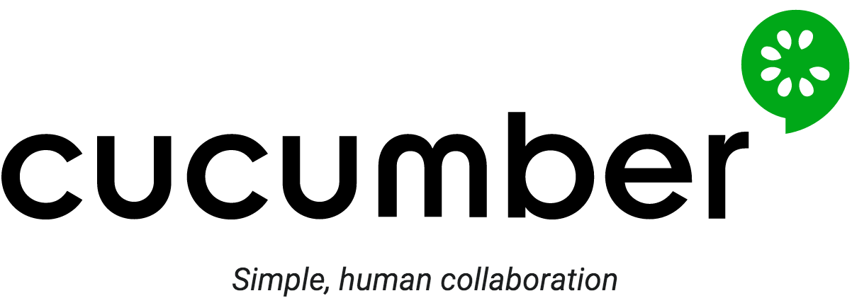













Integration Testing – Tooling
YADDA
APICLI
Notes:
Use the same tool that you are already using and confortable with.
You use In other stages of your development cycle.
This is what CS team is using.
Also put postman and apickli

Slide 37
Unit Testing

Slide 38

API Proxy Testing
Do you think it is possible to test an Apigee proxy
fully with integration testing?
No…

Slide 39
API Proxy Testing – Integration test enough?
Service Callouts?
Async?
3rd Party
Test Runner
Apigee
Target Systems
Notes:
Service callouts to other APIs – difficult to intercept, e.g. JS callout to Loggly
Difficult to simulate scenarios, e.g. timeouts, 500 errors, testing IP blacklisting
Isolated code units, e.g. IP blacklisting, security code, encryption, signature generation
Code coverage – especially important for critical code blocks, e.g. security

Slide 40
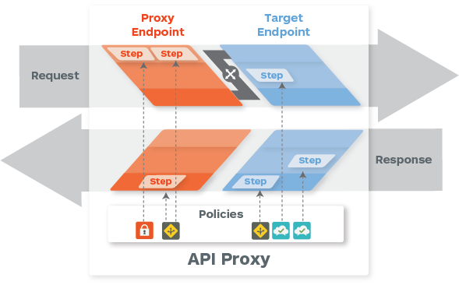


API Proxy Testing – Integration test enough?
Isolation/Coverage

Slide 41
Unit Testing – Other benefits
Code can be tested locally without deployment to Apigee first
Can create hooks to enforce testing during commit
Much faster than integration testing

Slide 42
Unit Testing – Boundary Principal
Test within your boundaries – don’t test libraries you don’t control

Slide 43
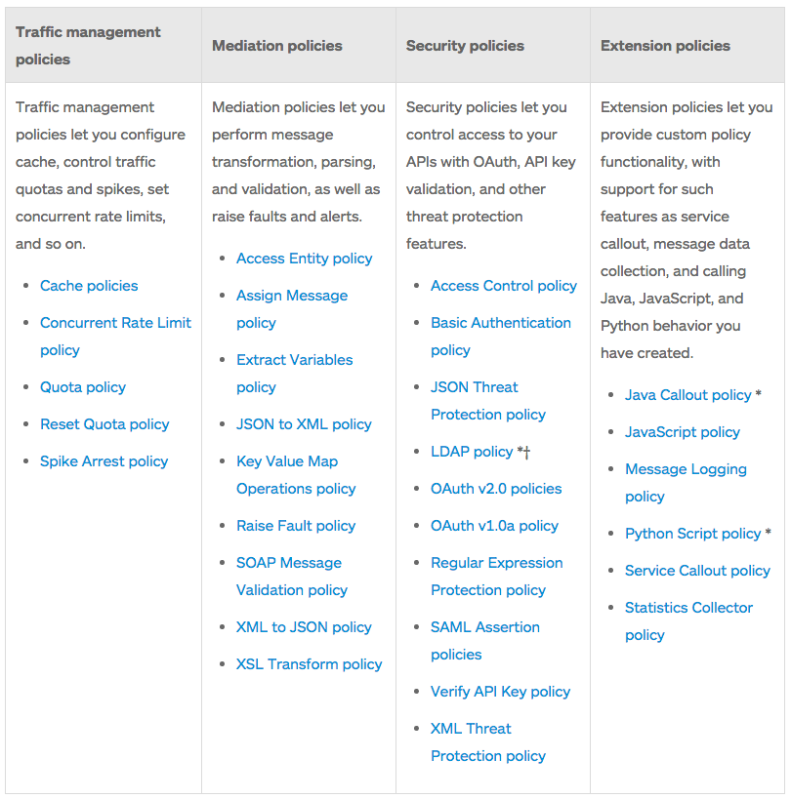
Unit Testing – Types of policies
Notes:
Apigee public documentation groups policies in the following categories.
Among these, the functionality for “traffic management”, “mediation” and “security” policies are implemented within the product itself. Code is implemented by Apigee engineering team – you don’t have access to it. Apigee engineering team have extensive unit testing suite for them.
But have a look at “Extension policies” – these policies let you provide custom functionality and extend Apigee proxy. For example JS policy lets you write your own javascript code to do whatever you want to do. These type of policies are candidates for unit testing.

Slide 44



Unit Testing – Tooling
Notes:
You can write custom code using Java, Javascript, Python and node.js. And these are the policies that are candidates for unit testing.
If you can execute all code branches using your integration testing, there might be no need for additional unit testing effort. My recommendation is to analyse the code and see if it can be categories in one of the cases I explained, like service callout to loggly.

Slide 45
Integration Testing – End-to-End Testing Session
Oct 14 – 11:40AM
END TO END TESTING: BUG SQUASHING FOR API DEVELOPERS

Slide 46
Documentation

Slide 47
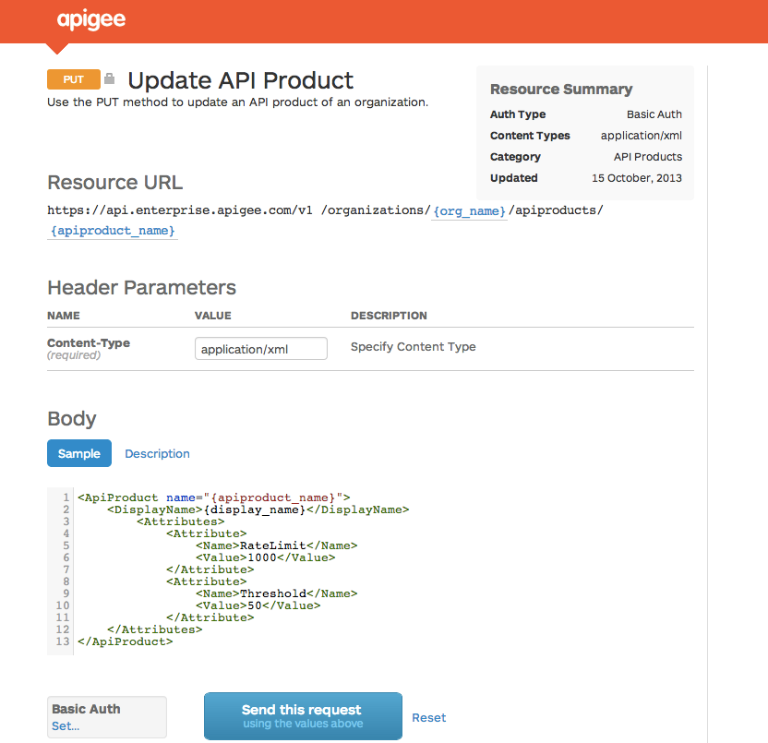




Programmable Documentation with SmartDocs
API Modeling
Describe an API structure
SmartDocs
Generate interactive documentation
API-based
Integrate with any portal / CMS
Apigee Edge Developer Services
Other CMS
gh-pages

Slide 48
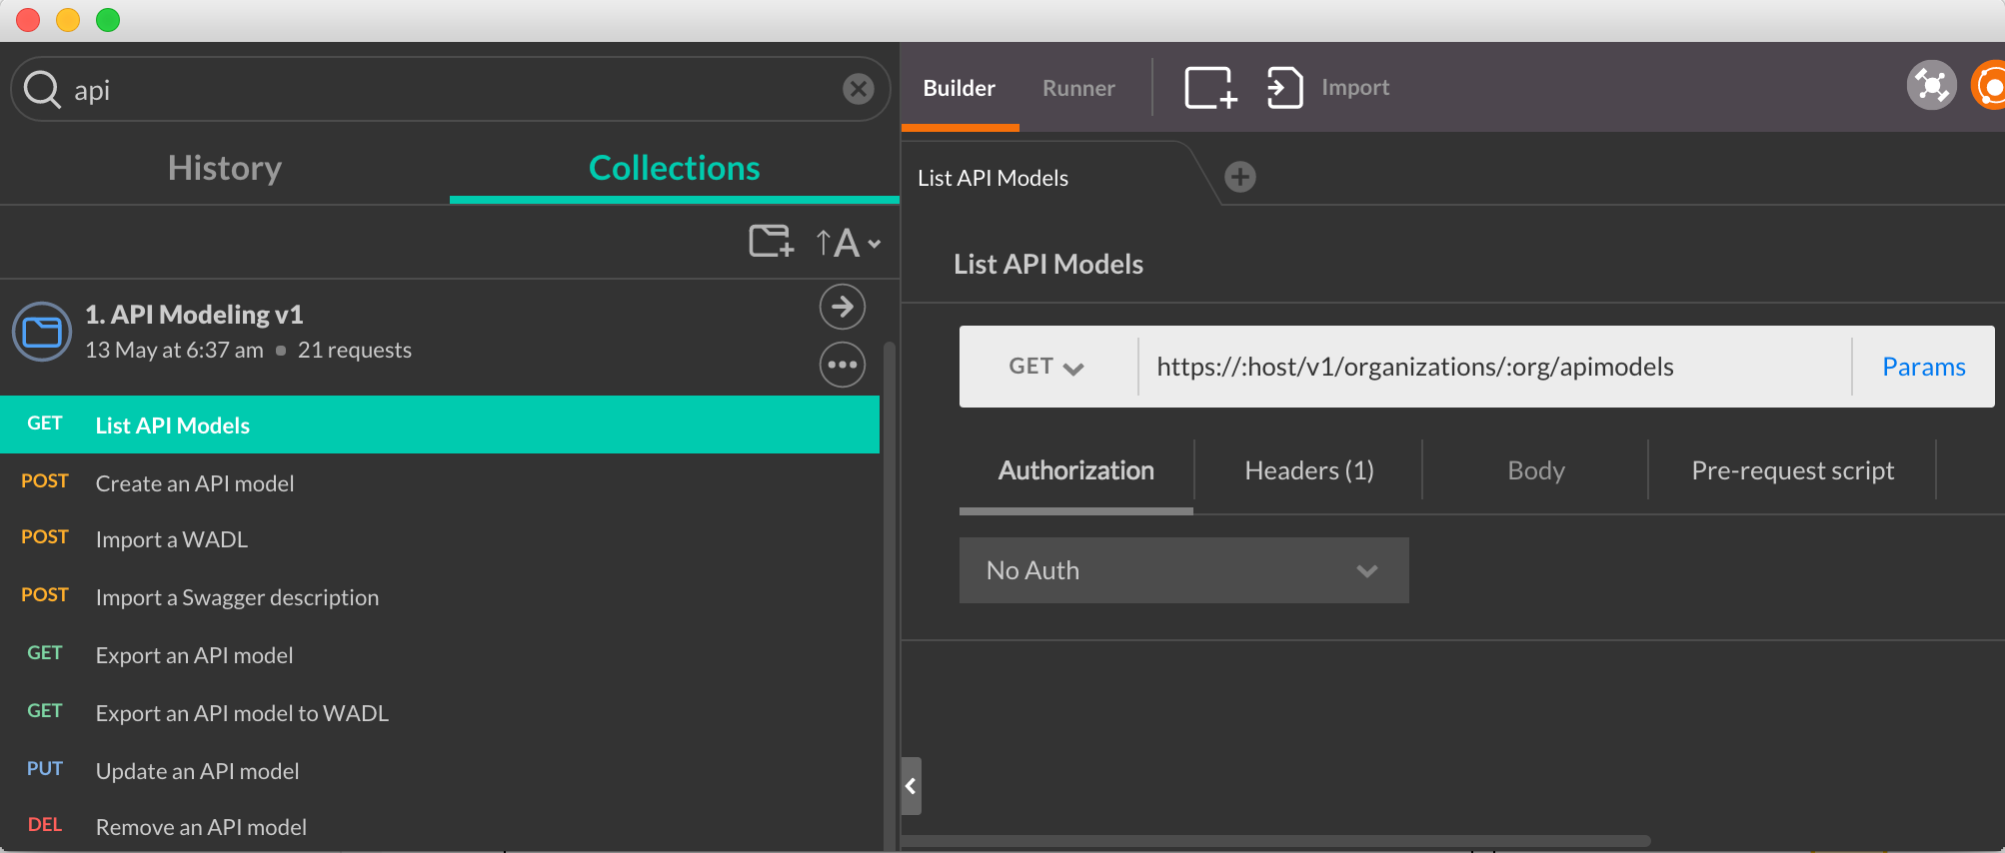
Programmable API Documentation with SmartDocs
Get it now! https://github.com/dzuluaga/apigee-tutorials/tree/master/apiproxies/sample-api-smartdocs

Slide 49
In Conclusion
CI doesn’t happen in a vacuum. So, enable the whole organization
Don’t reinvent the wheel. Leverage frameworks and community
Don’t let tools get on your way. They must be easy to adopt and maintain
It’s not a silver bullet, but if done right, it can make a huge difference
It won’t happen overnight. Master it with practice
Keep improving it

Slide 50
Questions?

